Slide 1
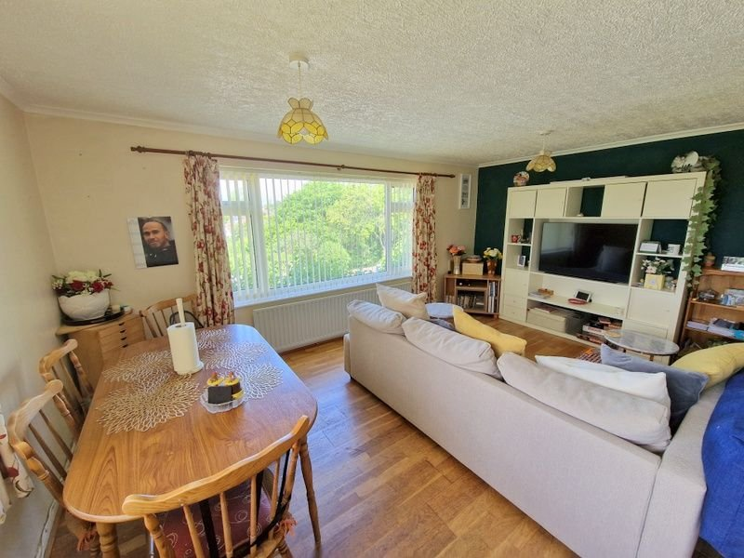
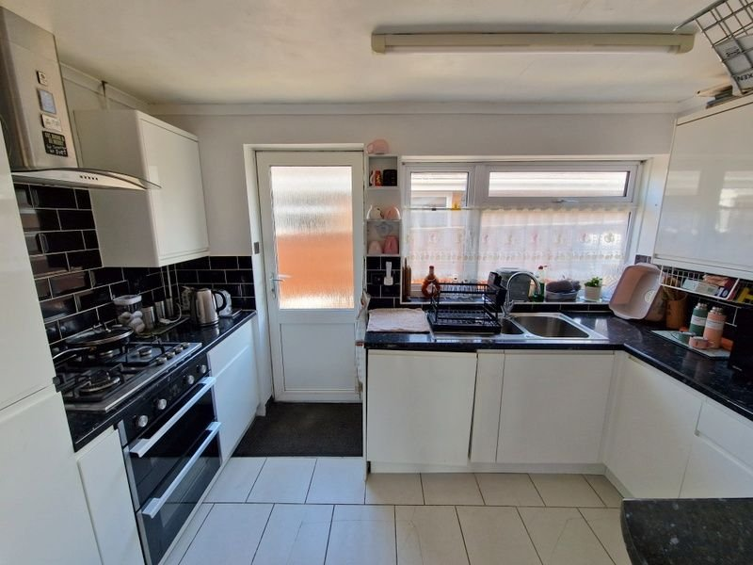
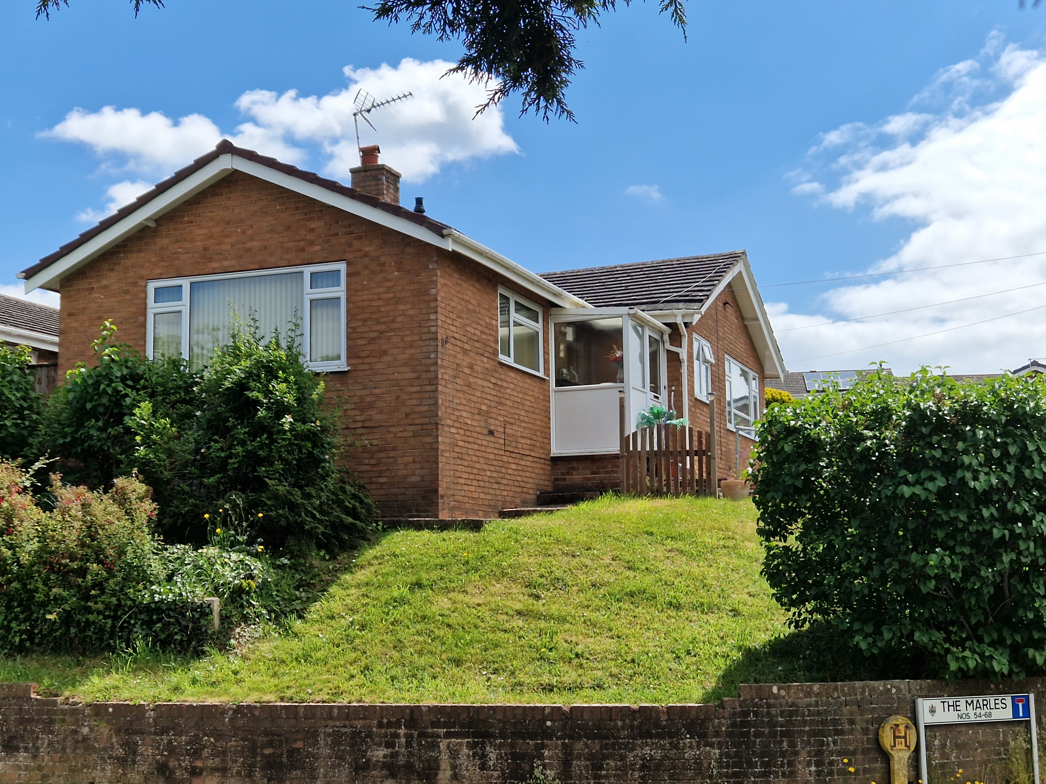
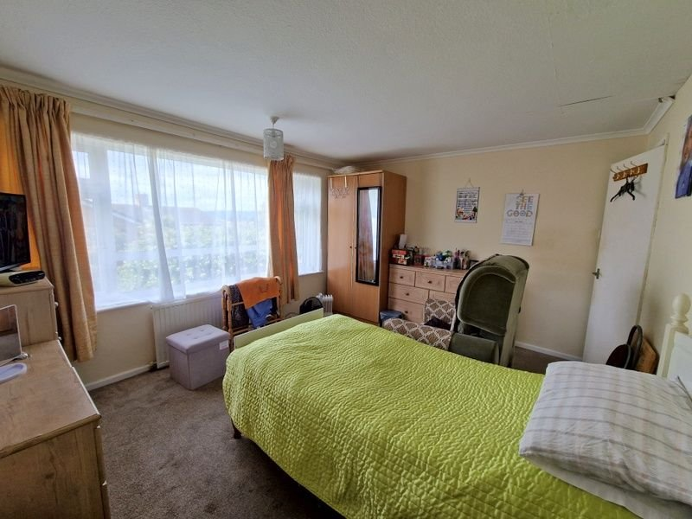
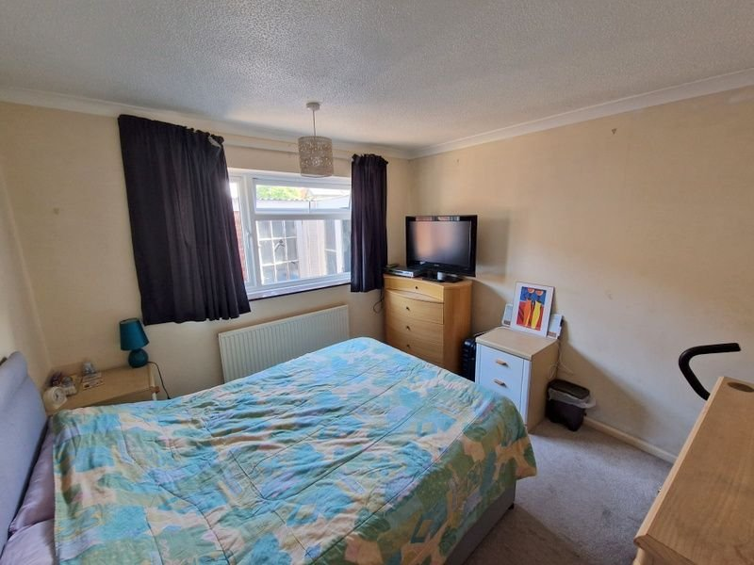
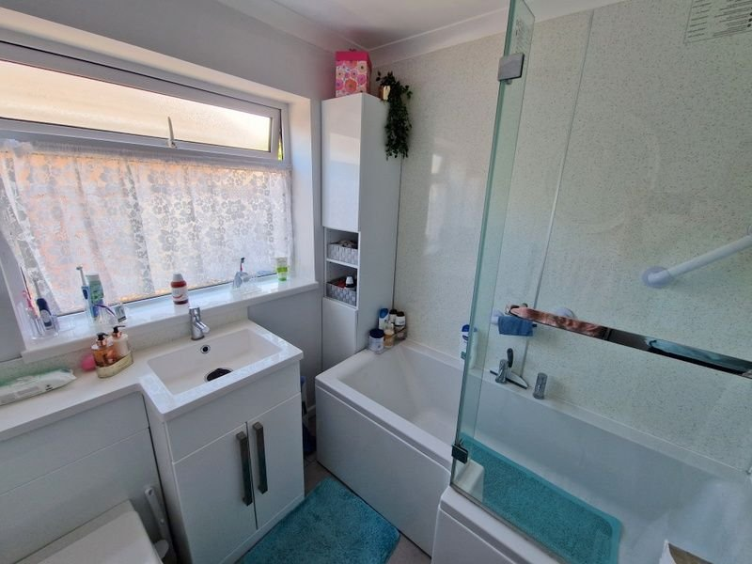
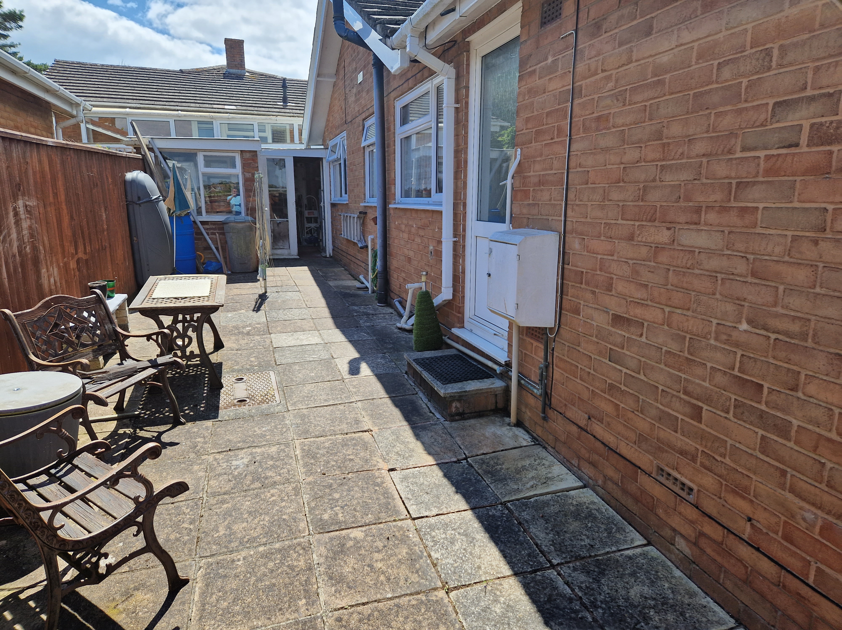
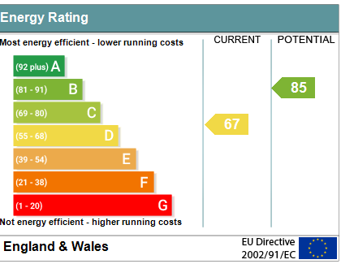
www.pennys.net
68 The Marles, Exmouth, EX8 4NS
GUIDE PRICE £325,000
TENURE Freehold
A Bright And Spacious Three Bedroom Detached Bungalow Located In A Popular Location Close To Amenities With Driveway, Larger Than Average Garage And Pleasant Outlook With Views Towards The Estuary
Entrance Porch And Reception Hall * Dual Aspect Lounge/Dining Room * Kitchen/Breakfast Room * Three Bedrooms * Modern Bathroom Suite * Gas Central Heating * Double Glazing * Corner Plot Gardens * Large Garage * Viewing Recommended
Pennys Estate Agents Limited for themselves and for the vendor of this property whose agents they are give notice that:- (1) These particulars do not constitute any part of an offer or a contract. (2) All statements contained in these particulars are made without responsibility on the part of Pennys Estate Agents Limited. (3) None of the statements contained in these particulars are to be relied upon as a statement or representation of fact. (4) Any intending purchaser must satisfy himself/herself by inspection or otherwise as to the correctness of each of the statements contained in these particulars. (5) The vendor does not make or give and neither do Pennys Estate Agents Limited nor any person in their employment has any authority to make or give any representation or warranty whatever in relation to this property.
PENNYS ESTATE AGENTS
2 Rolle House, Rolle Street, Exmouth, Devon, EX8 2SN
Tel: 01395 264111 EMail: help@pennys.net

Slide 2
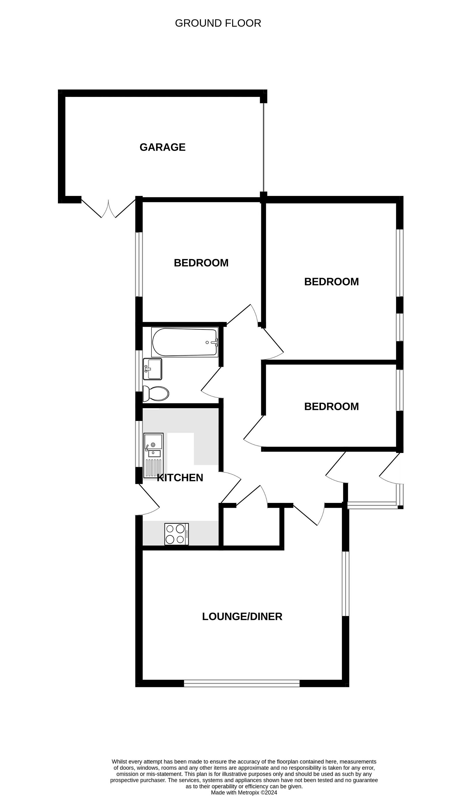
68 The Marles, Exmouth, EX8 4NS
THE ACCOMMODATION COMPRISES: uPVC front door with patterned glass window inset to:
ENTRANCE PORCH: With double glazed windows with patterned glass, inner glazed patterned door to:
RECEPTION HALL: Wood flooring, radiator, coats cupboard.
LOUNGE/DINING ROOM: 5.03m x 4.27m (16'6" x 14'0") maximum. A bright dual aspect room with double glazed windows to front and side aspects enjoying a pleasant outlook and enjoying an open outlook with views to the estuary and coastline beyond. Feature wood flooring, TV point, telephone point, radiator.
KITCHEN: 3.51m x 2.06m (11'6" x 6'9") Fitted with a range of patterned gloss finish worktops extended to provide a breakfast bar area with tiled surrounds, cupboards, drawer units, plumbing for automatic washing machine beneath, inset one and a half bowl single drainer sink unit, matching wall mounted cupboards, integrated fridge and freezer, inset four ring gas hob with built-in oven below and stainless steel chimney extractor hood over. Double glazed window to side aspect and double glazed door with patterned glass giving access to outside. Tiled floor.
BEDROOM 1: 3.96m x 3.35m (13'0" x 11'0") Double glazed window to front aspect, radiator.
BEDROOM 2: 3.02m x 3.12m (9'11" x 10'3") Double glazed window to rear aspect, radiator.
BEDROOM 3: 3.33m x 2.08m (10'11" x 6'10") With wood flooring, radiator, double glazed window to front aspect.
BATHROOM/WC: Stylishly fitted with modern suite comprising bath with Mira shower unit over, shower splash screen and splashback walls, wash hand basin with chrome mixer tap and cabinet beneath with adjoining display surface with WC push button flush under, mirror fronted medicine cabinet, chrome heated towel rail, double glazed window with patterned glass, tiled floor.
OUTSIDE: The property enjoys a slightly elevated position with gardens to the front and side of the bungalow. Driveway with off road parking leading to the larger than average garage. To the rear of the property is an enclosed patio garden with pedestrian gate to side garden. Outside cold water tap and access to:
UTILITIES CUPBOARD: With plumbing for automatic washing machine, space for tumble dryer, light and power connected.
GARAGE: 6.4m x 2.49m (21'0" x 8'2") widening to 3.1m (10'2") With double doors giving access to the enclosed rear garden.
FLOOR PLAN:

